Slide 1
NYC Housing
Ray She

Slide 2
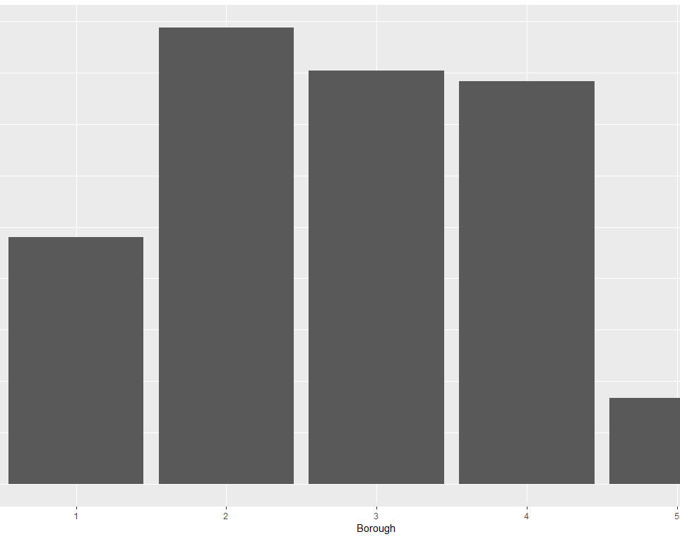
1991-2017 Bourough

Slide 3
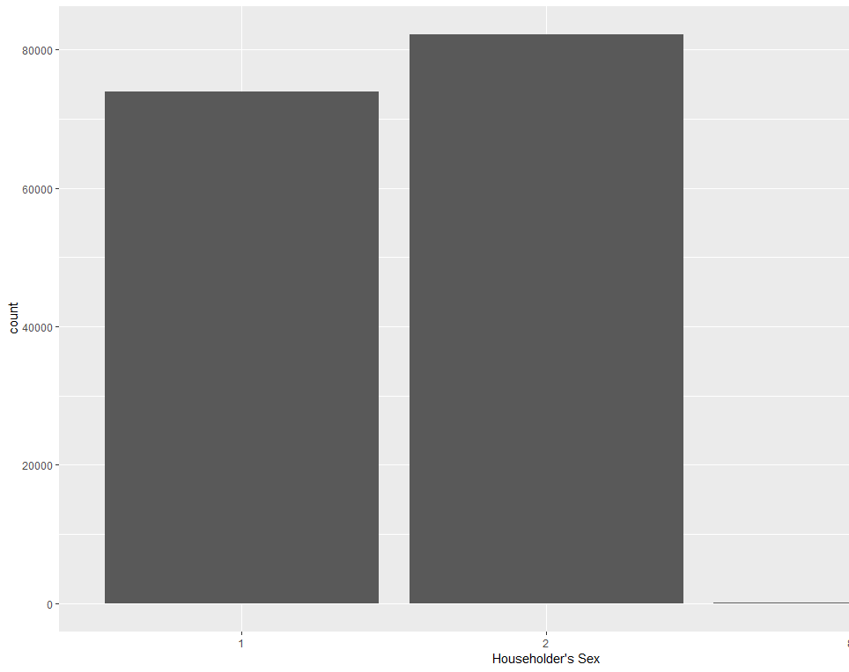
1991-2017 Gender

Slide 4
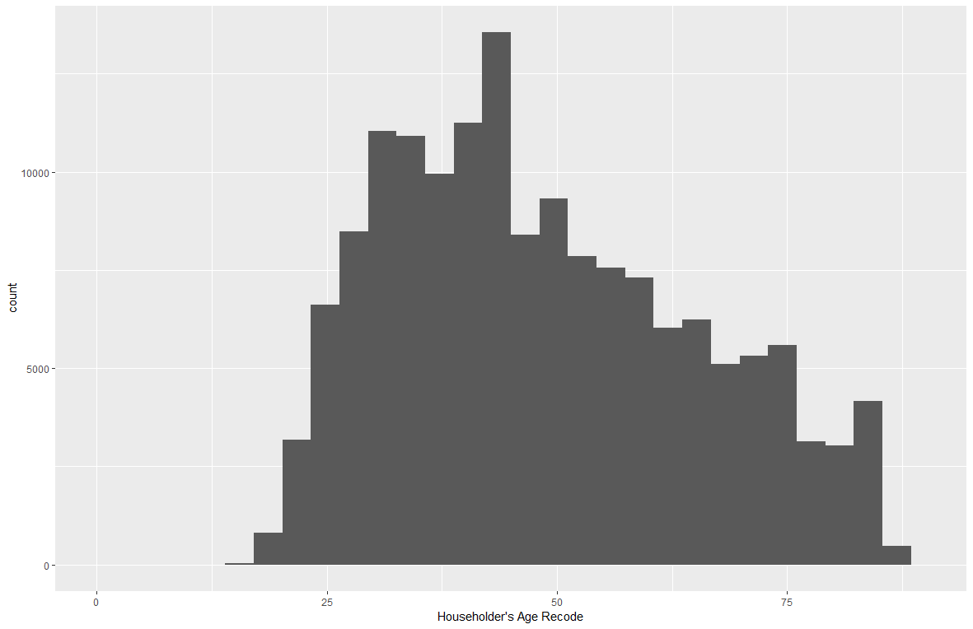
1991-2017 Age
Min. 1st Qu. Median Mean 3rd Qu. Max.
15.00 35.00 46.00 48.83 61.00 98.00

Slide 5
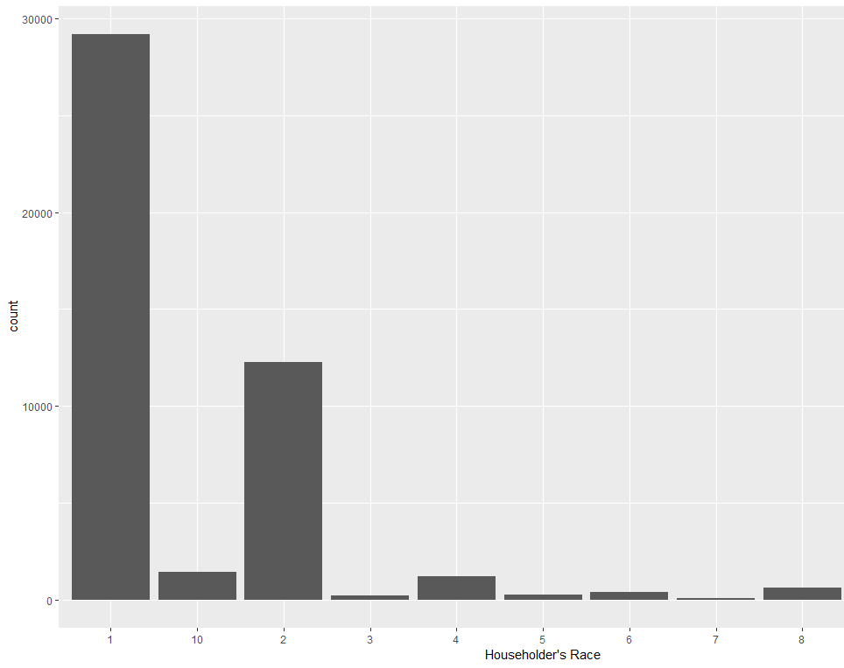
1991-1996 Race

Slide 6
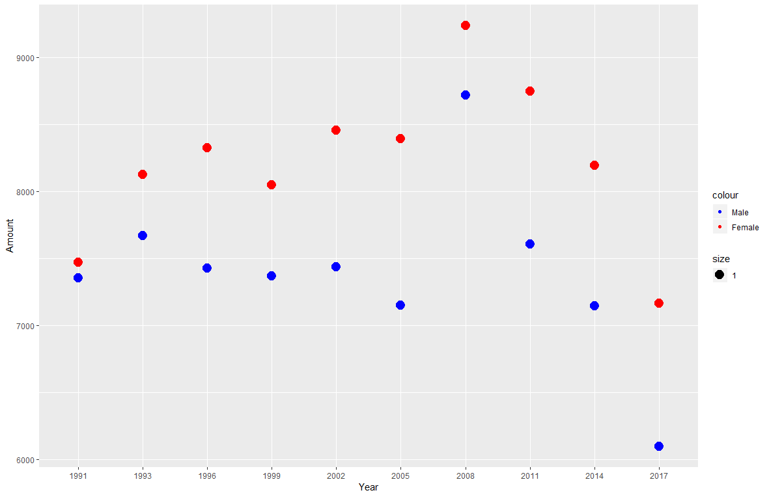

Slide 7
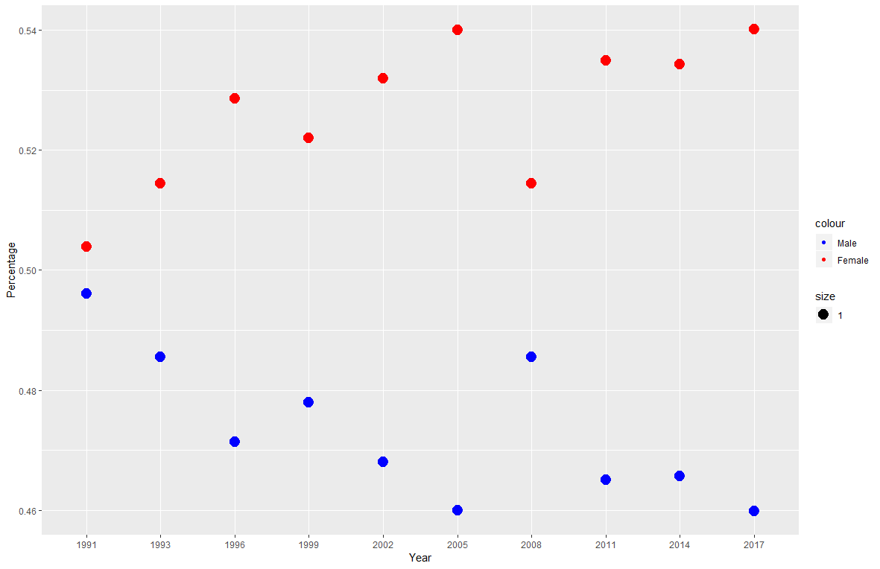

Slide 8
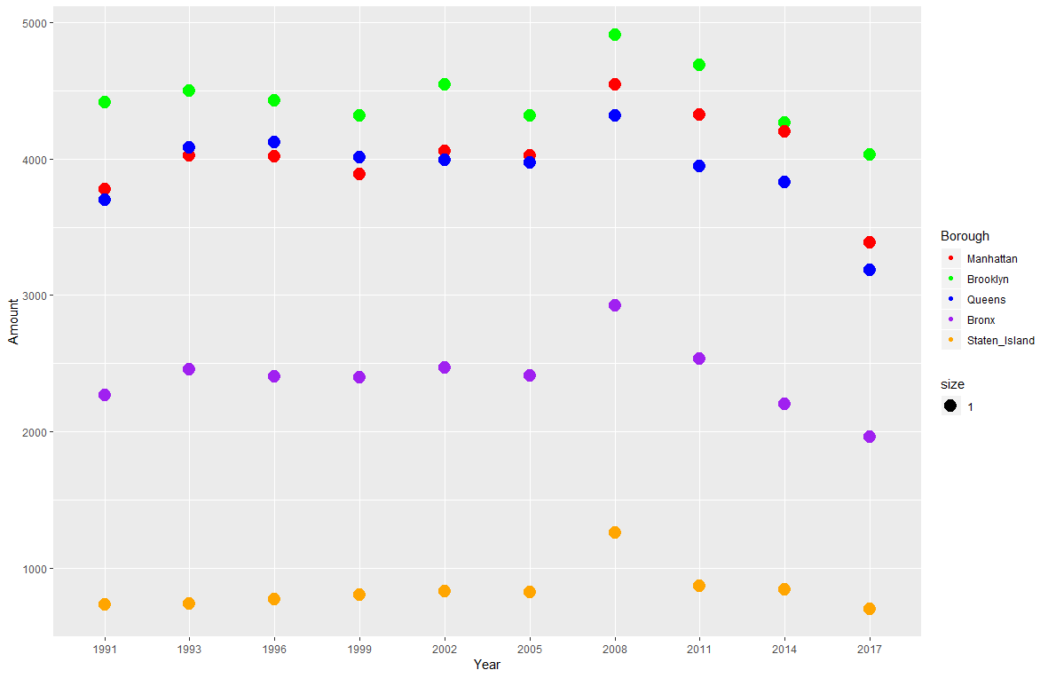

Slide 9
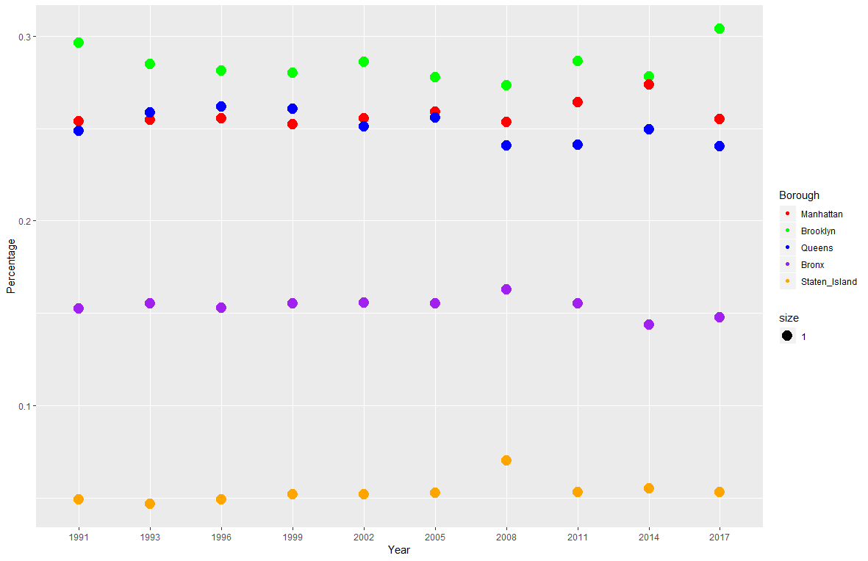

Slide 10
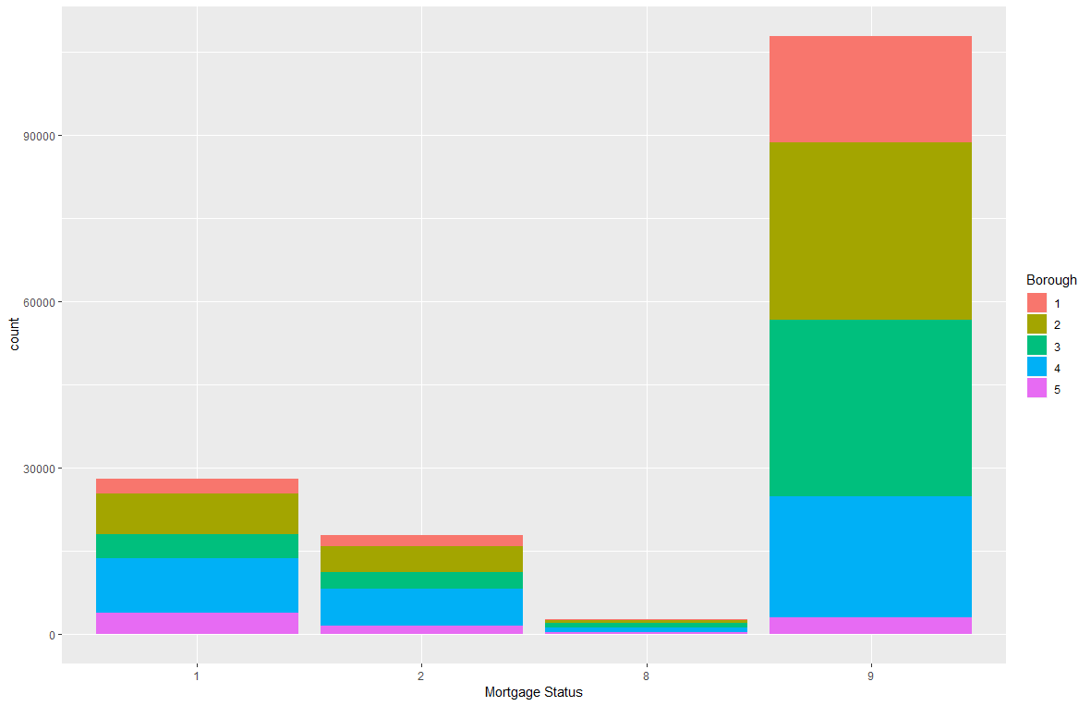
Mortgage status vs borough

Slide 11
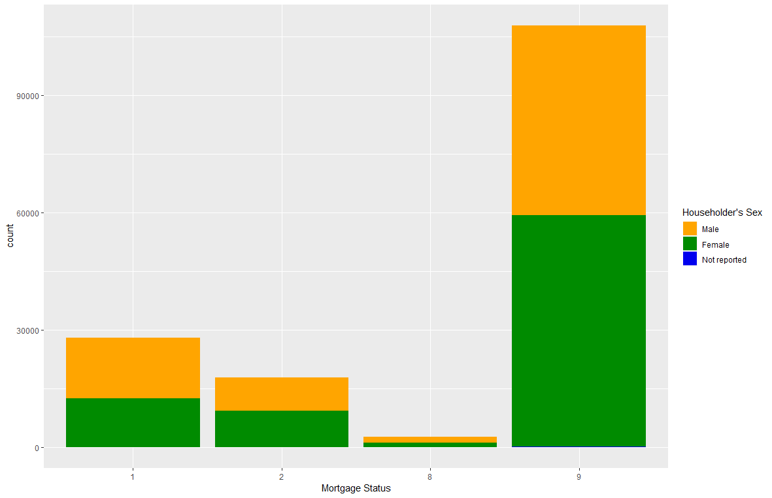
Mortgage status vs gender

Slide 12
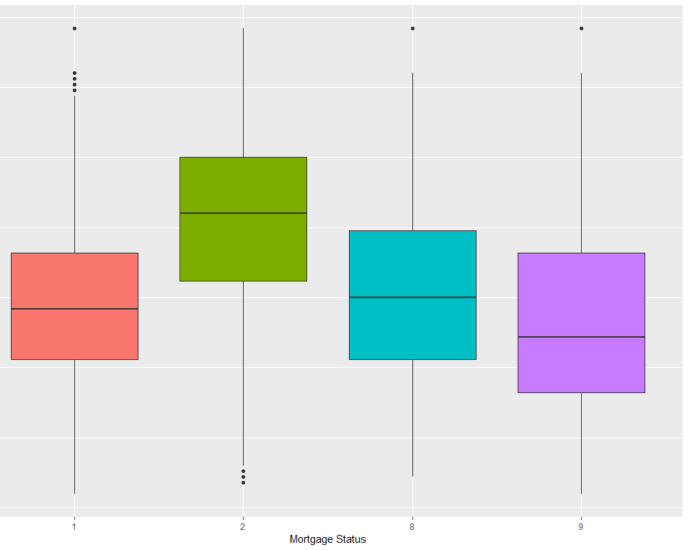
Mortgage status vs Age

Slide 13
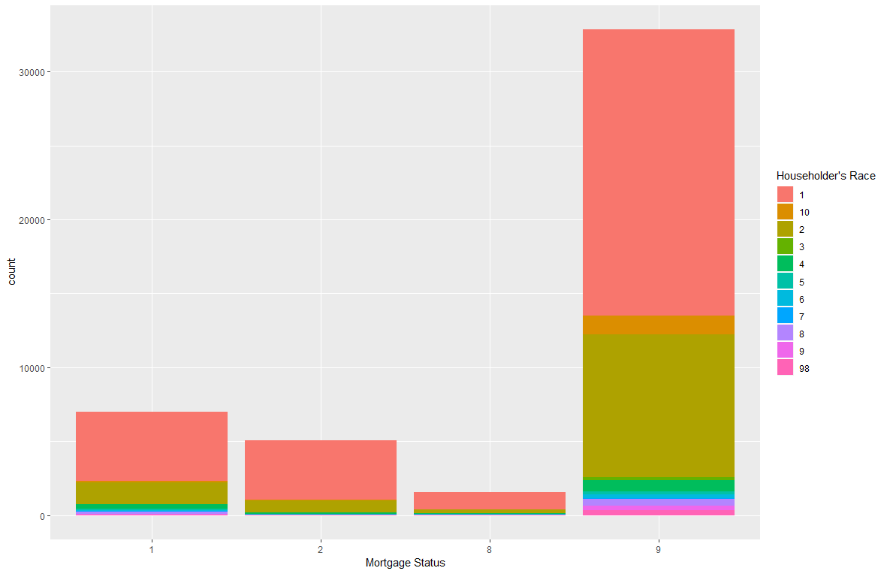
Mortgage status vs race

Slide 14
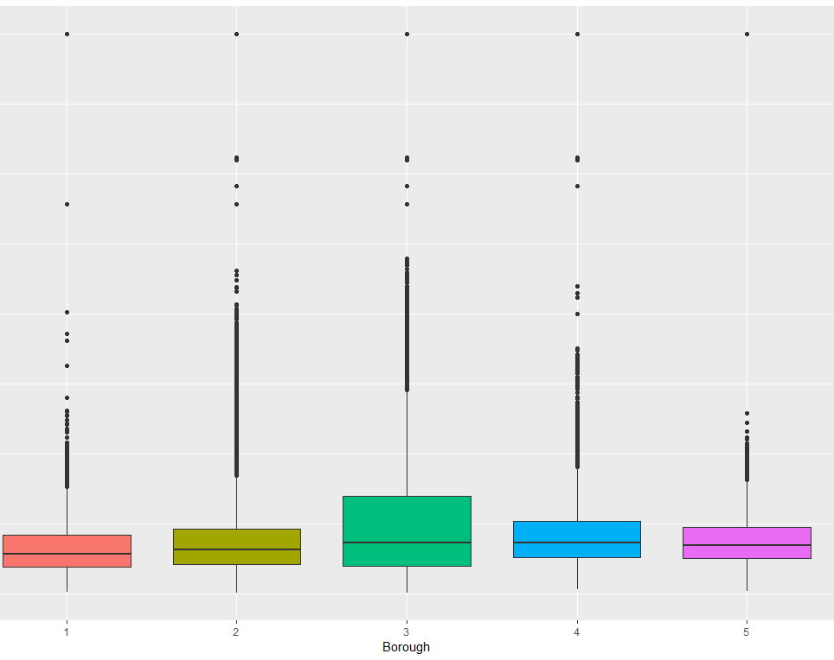
Monthly rent vs borough

Slide 15
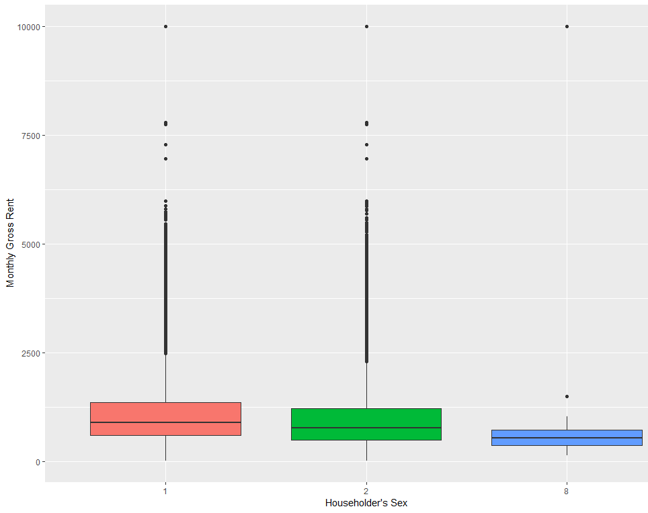
Monthly rent vs gender

Slide 16
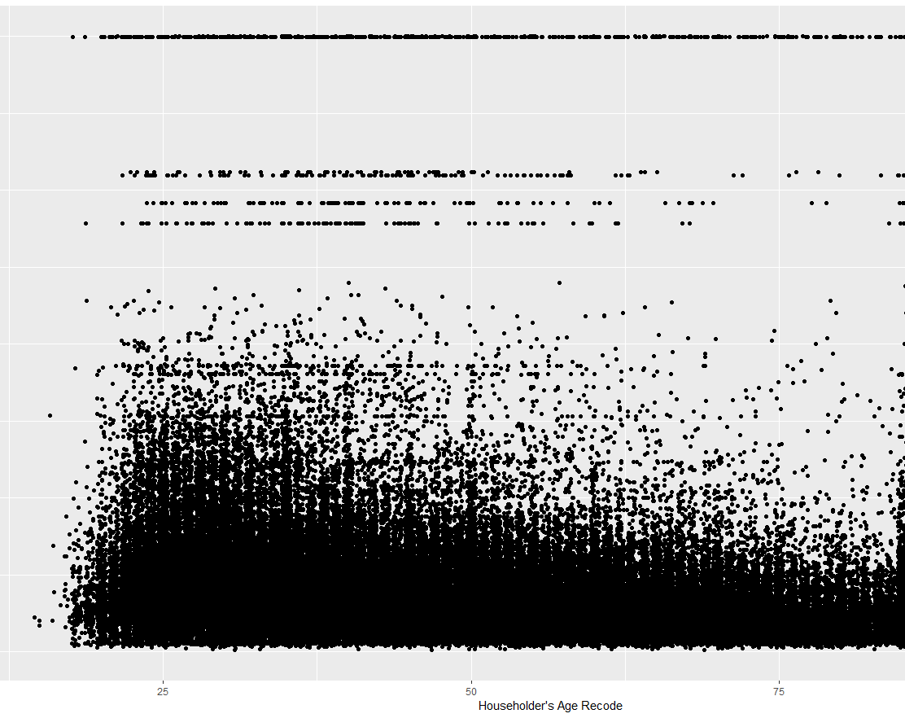
Monthly rent vs Age

Slide 17
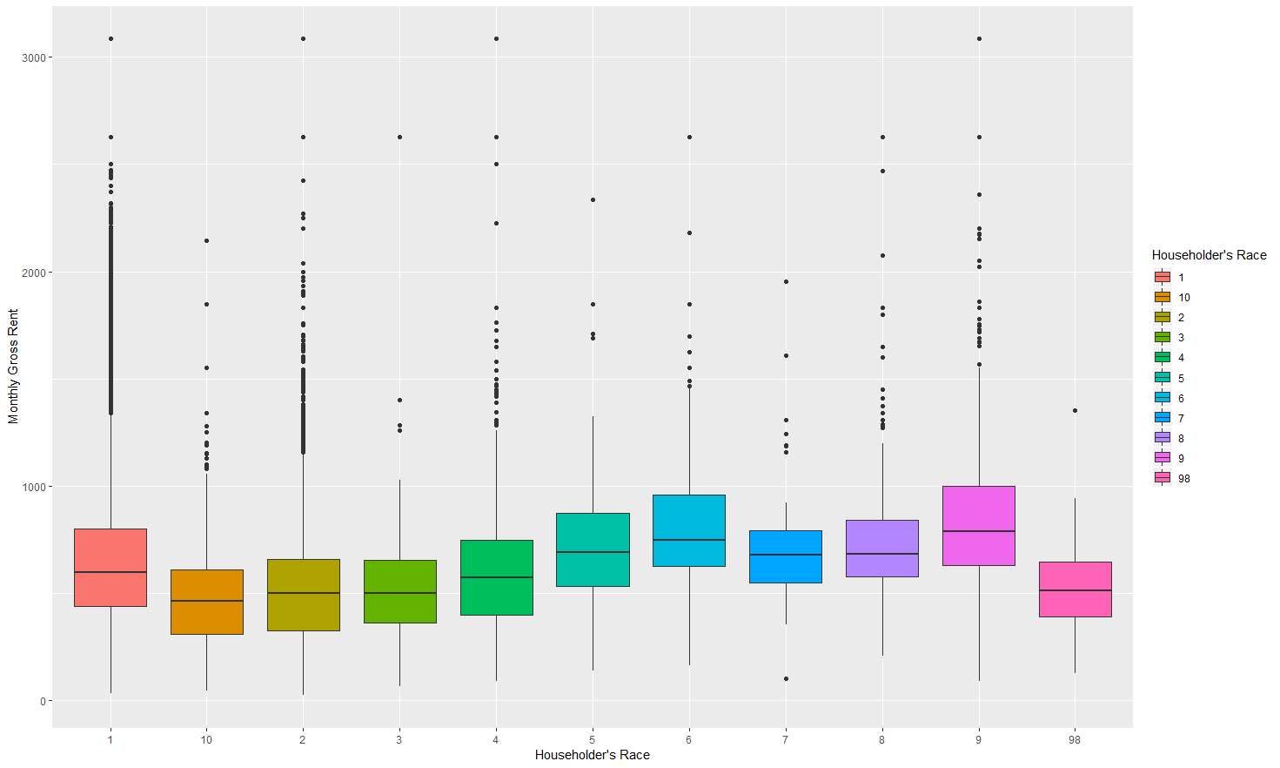
Monthly rent vs race

